Slide 1
UMAP分析基因表現量的組織特異性
2021.06.09
周治瑗

Slide 2
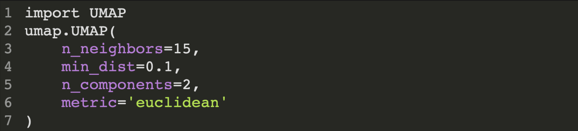
INTRODUCTION OF HYPERPARAMETERS IN UMAP

Slide 3
n_neighbors - the number of neighbors - balance local v.s. global structure - range frpm 2 to 200
min_dist - minimum distance to aprt points - compactness of all points distribution - range from 0.0 to 0.99
n_components - determine dimensionality of reduced dimensions - usually set as 1 or 3
metric - enclidean, manhattan, chebyshev, minkowski, canberra, braycurtis, haversine, mahalanobis, cosine, hamming…

Slide 4
UMAP INPLEMENTATION AND INTERPRETATION

Slide 5
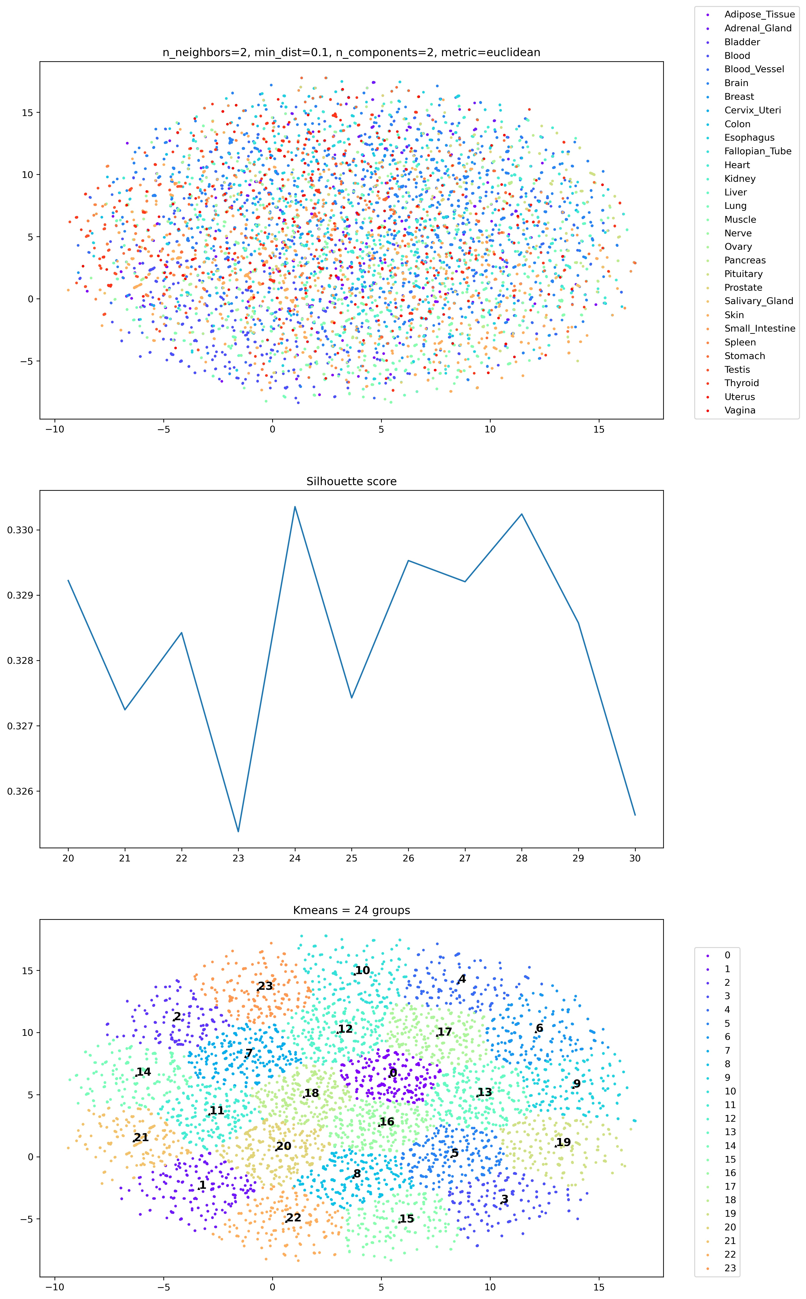
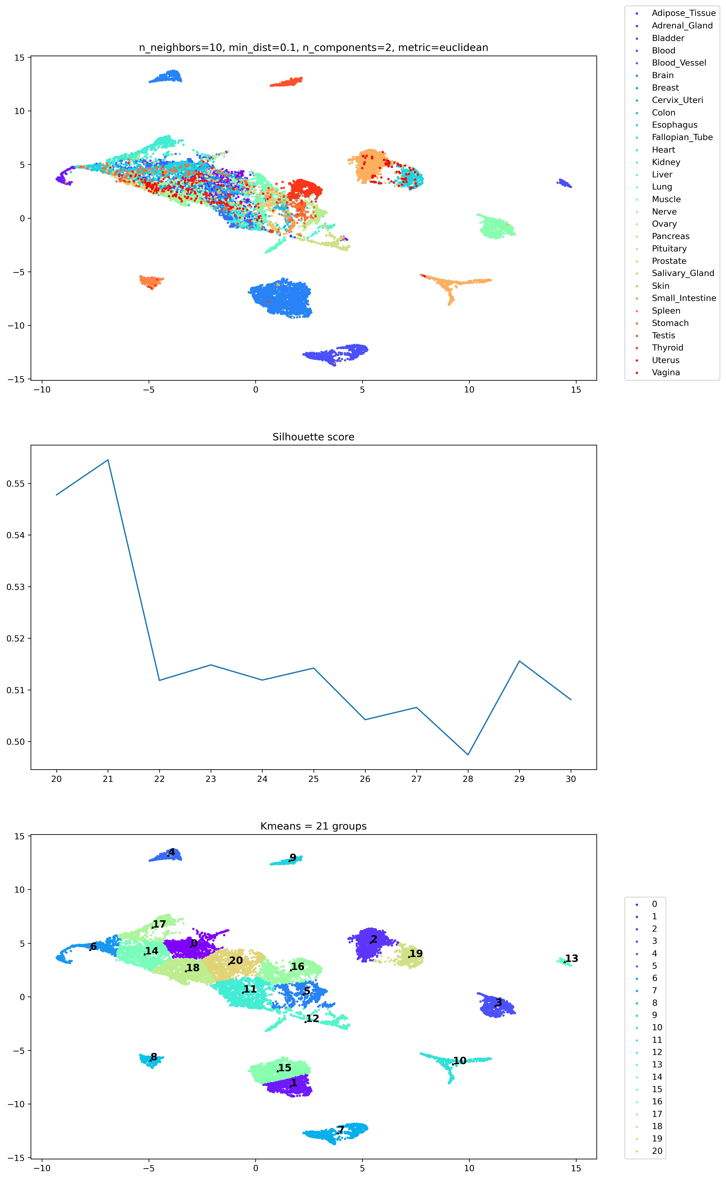
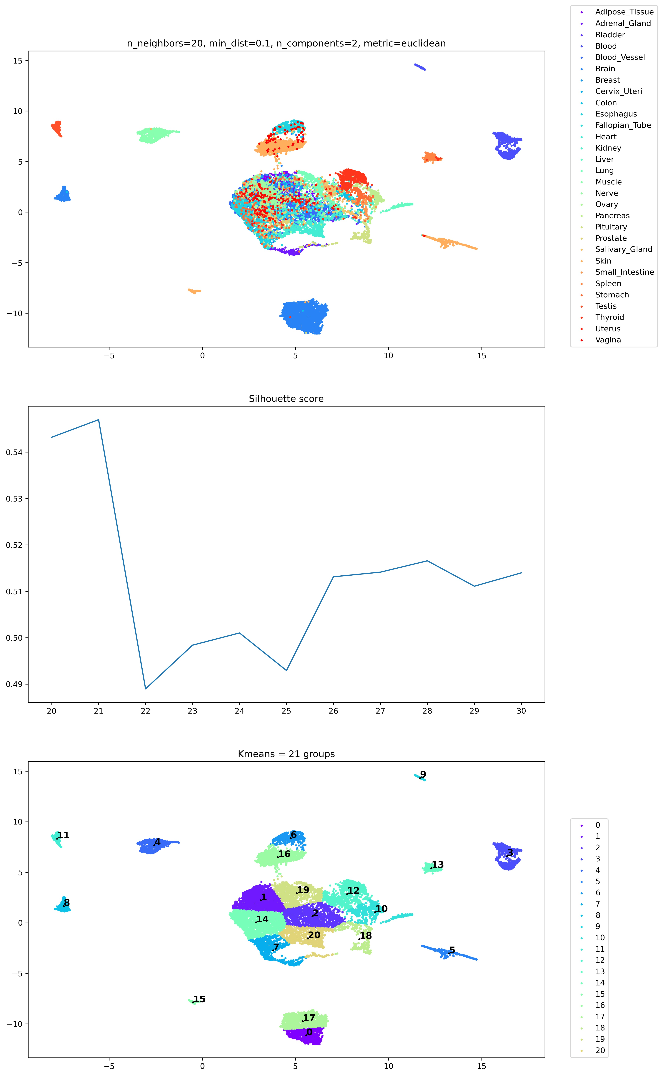
n_neighbors

Slide 6
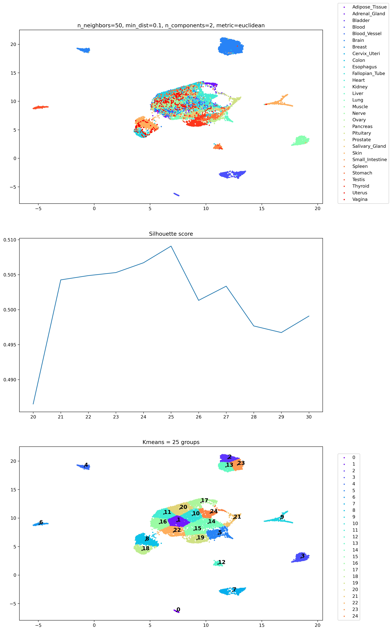
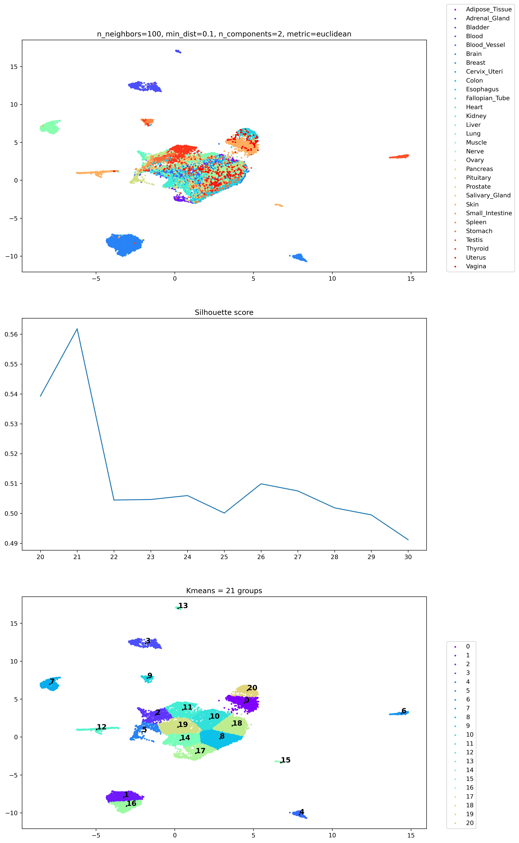
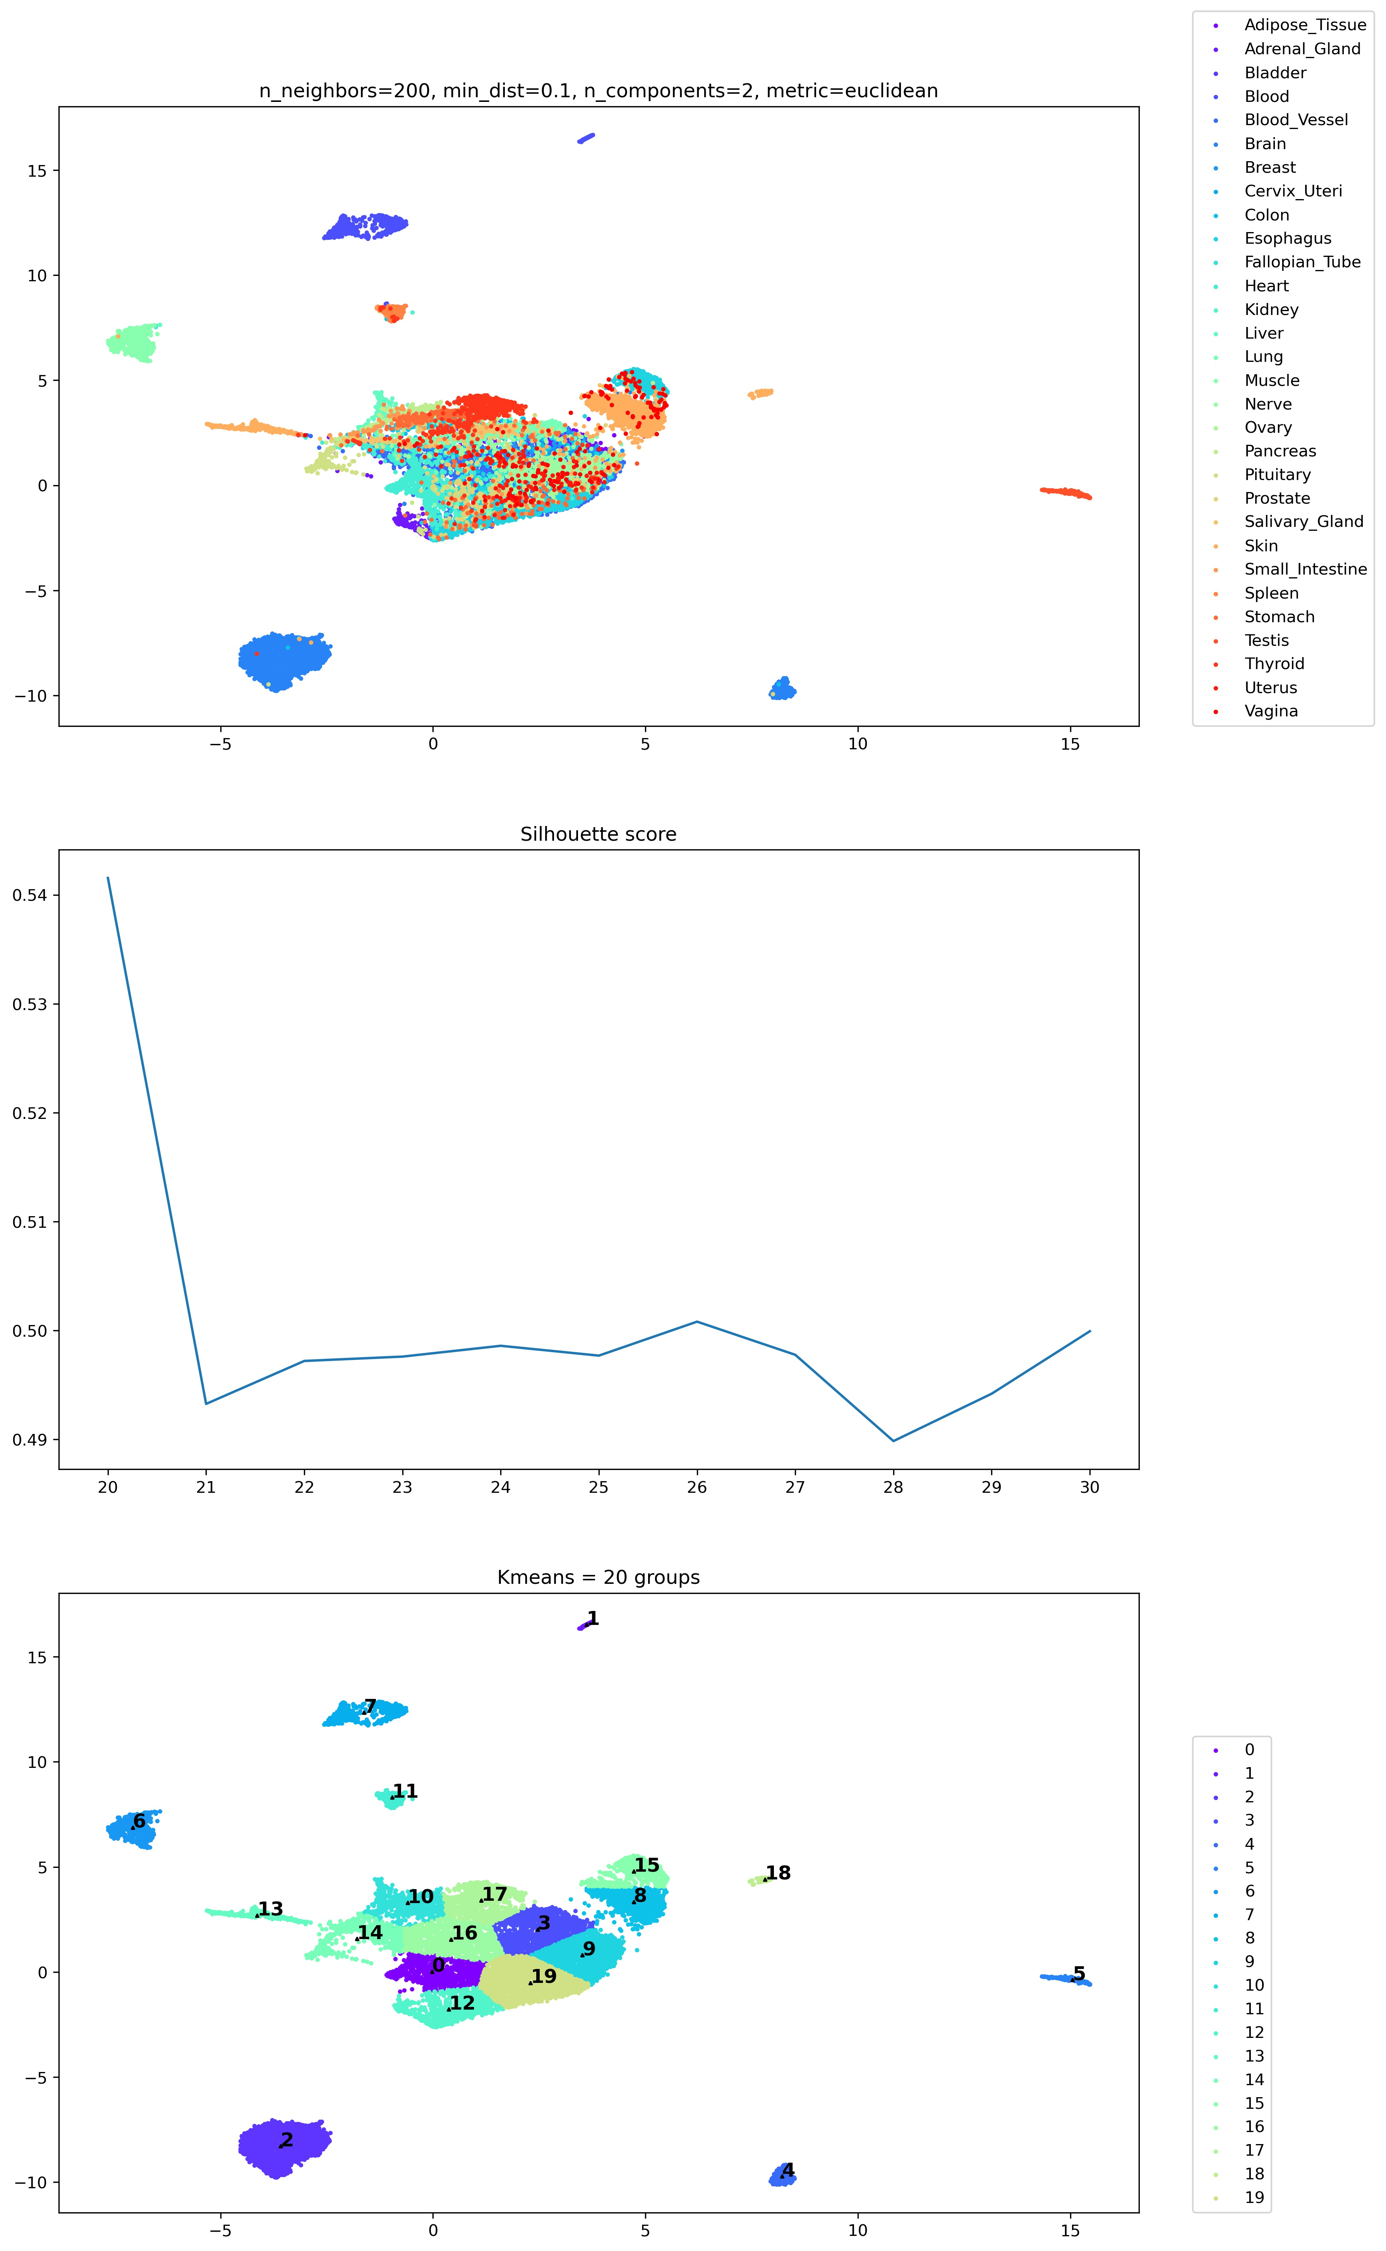
n_neighbors

Slide 7
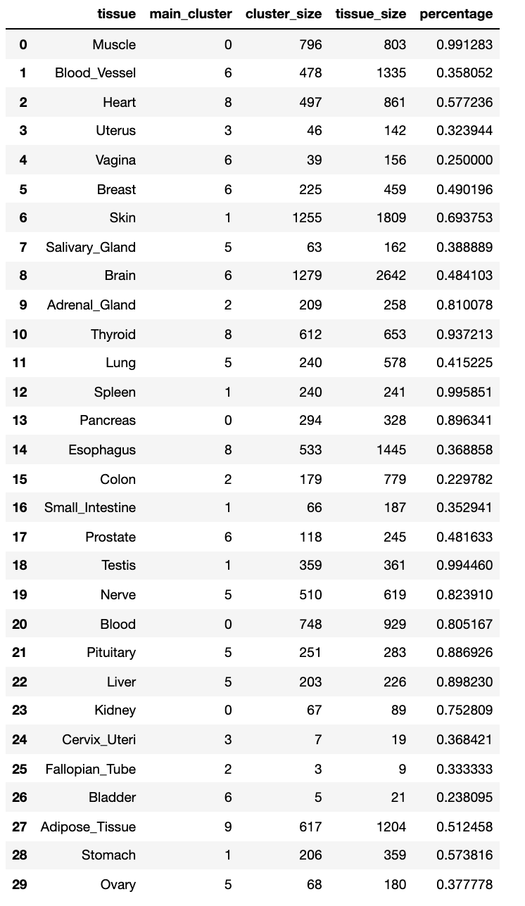
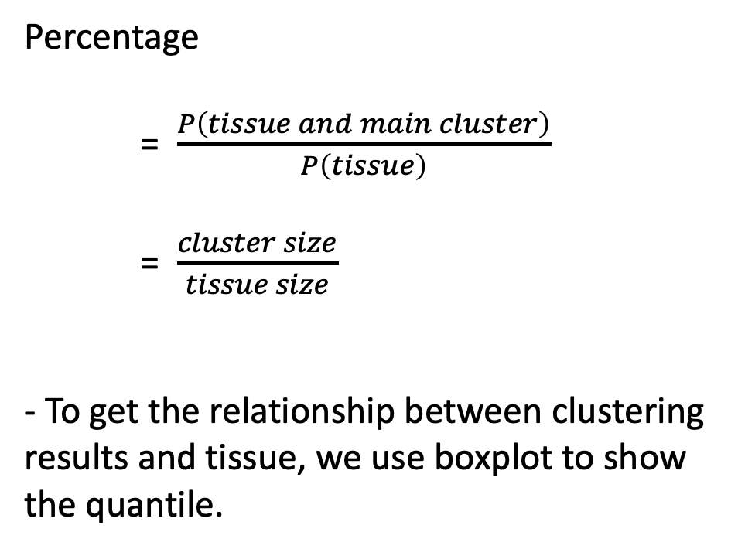
Cluster results mapping to tissue classifications
Percentage
= $\frac{P\left(tissue and main cluster\right)}{P\left(tissue\right)}$
= $\frac{cluster size}{tissue size}$
- To get the relationship between clustering results and tissue, we use boxplot to show the quantile.

Slide 8
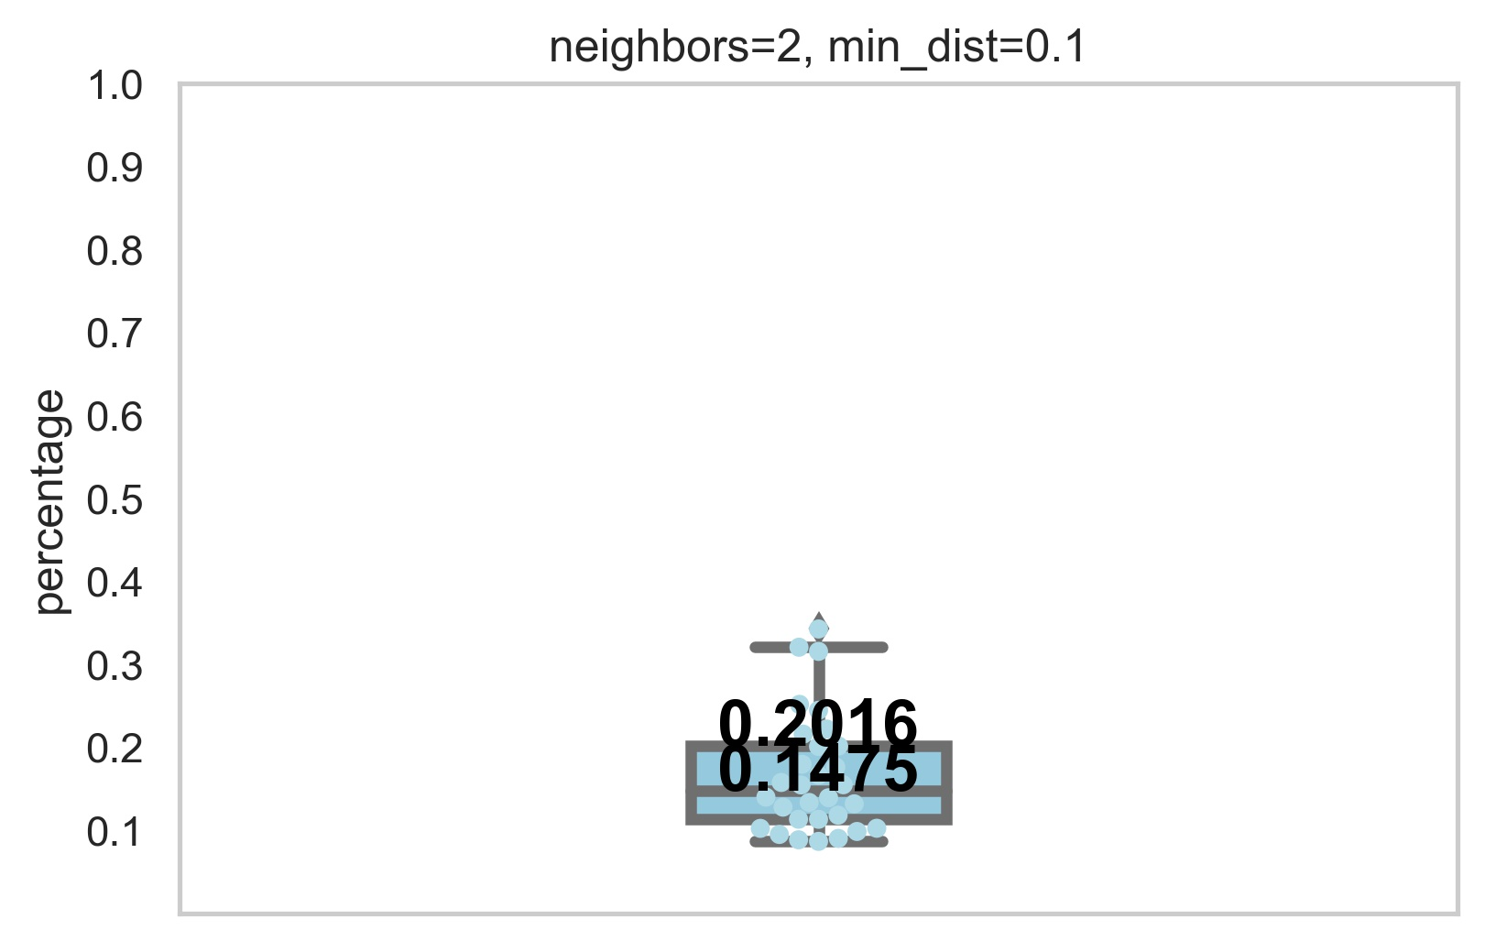
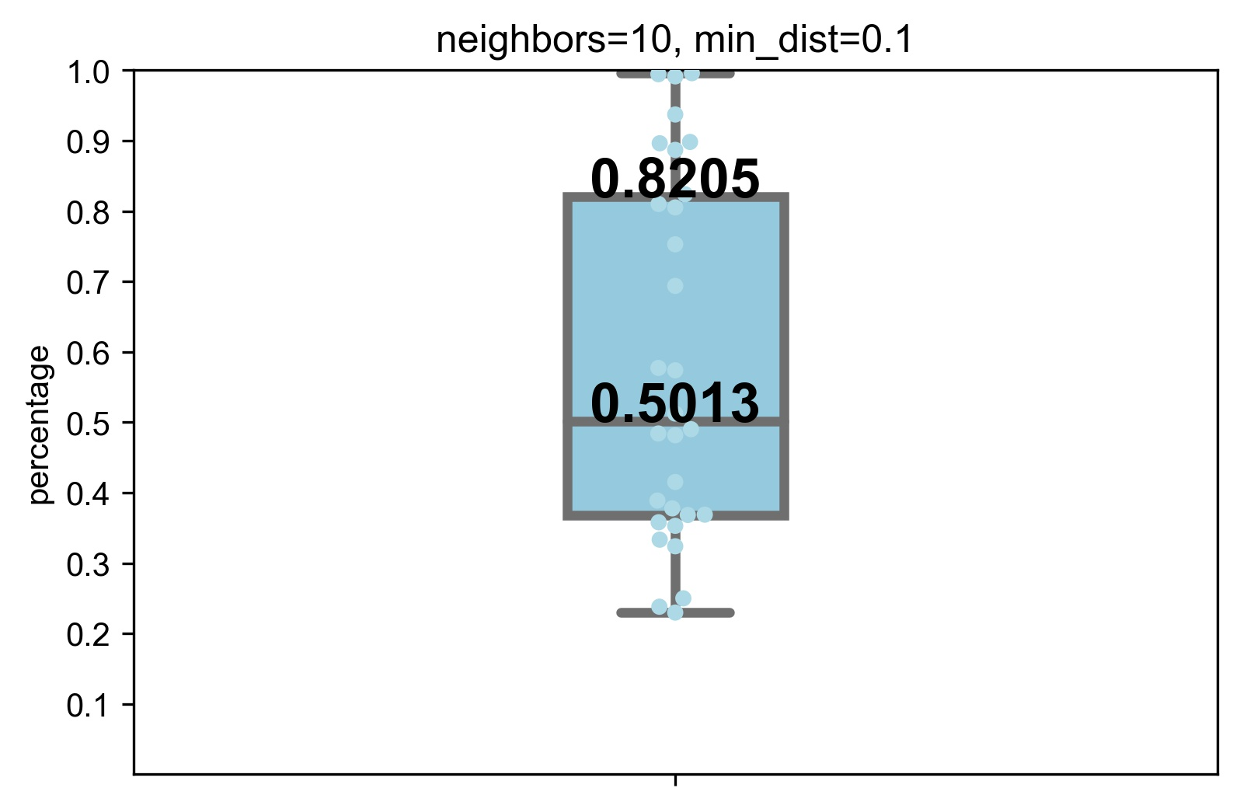
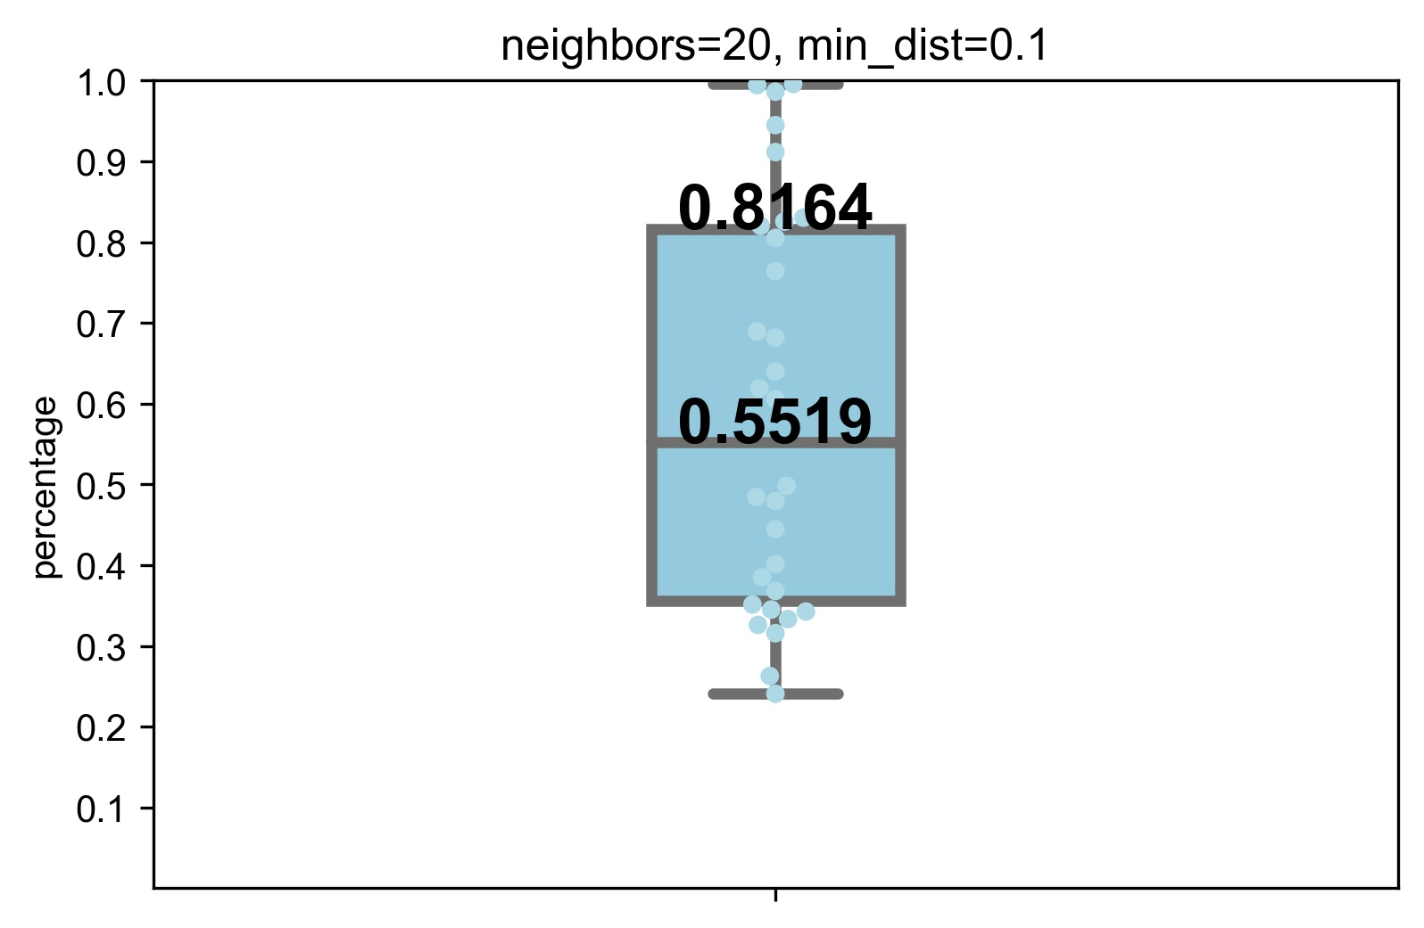
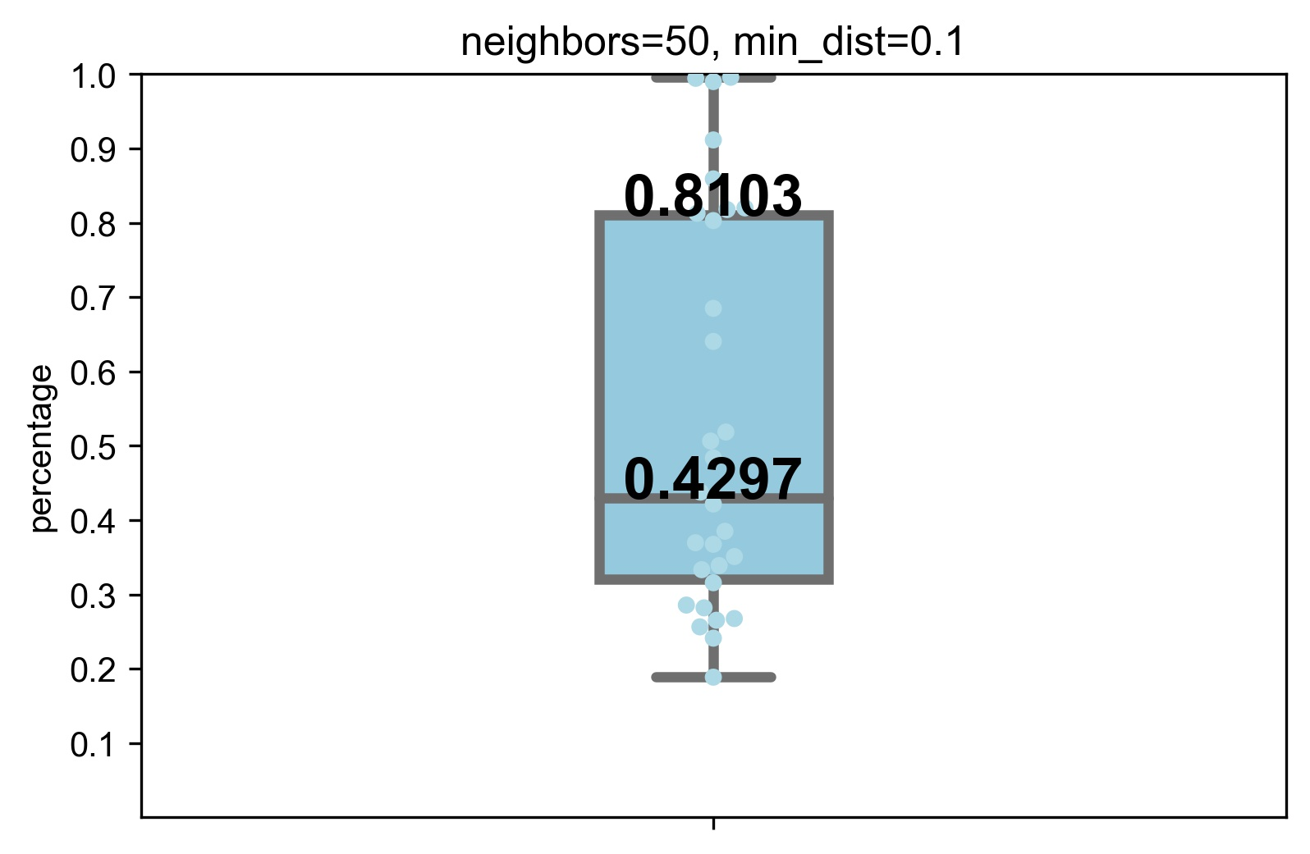
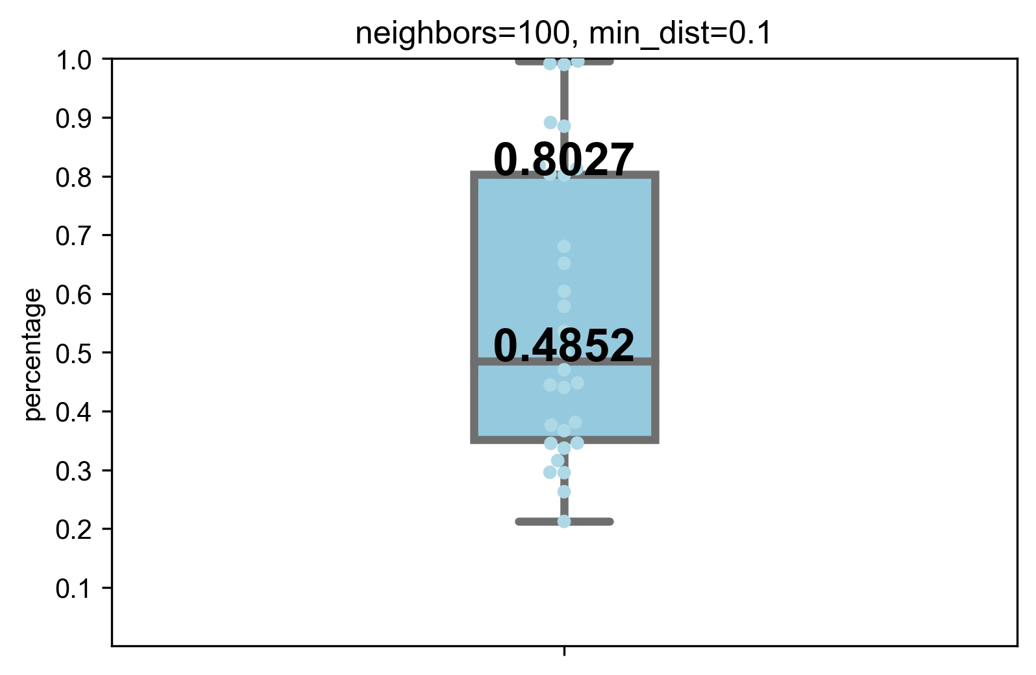

Cluster results mapping to tissue classifications

Slide 9
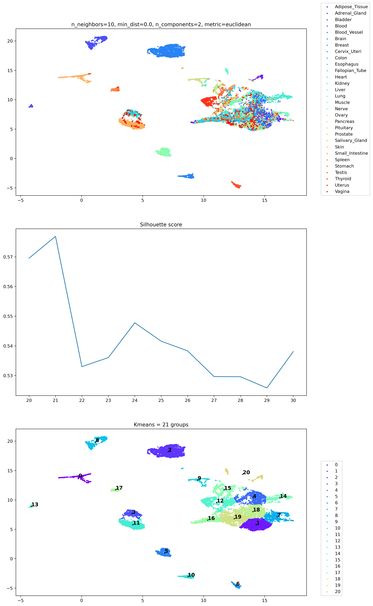
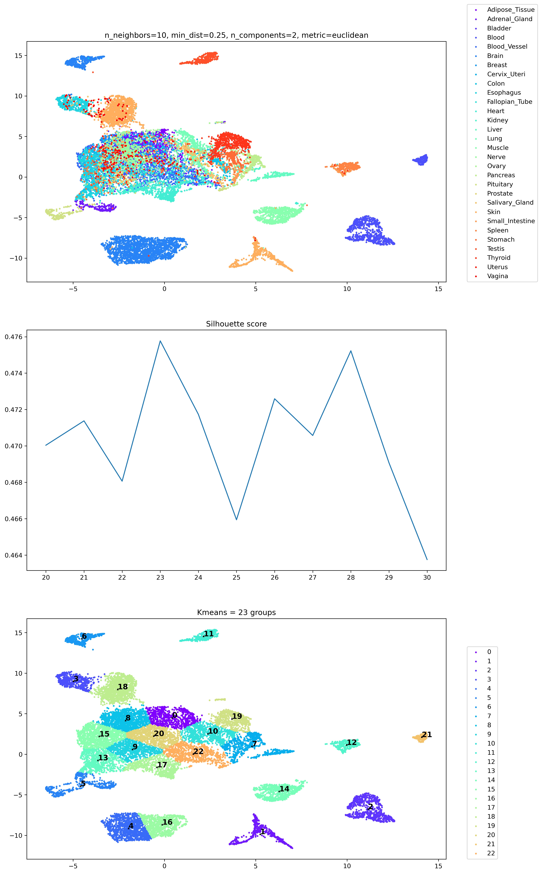
min_dist

Slide 10
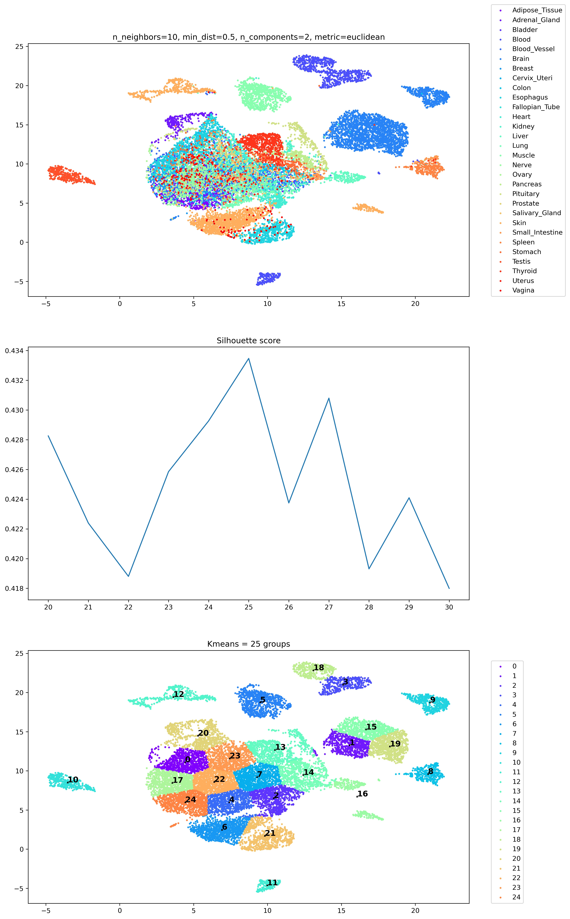
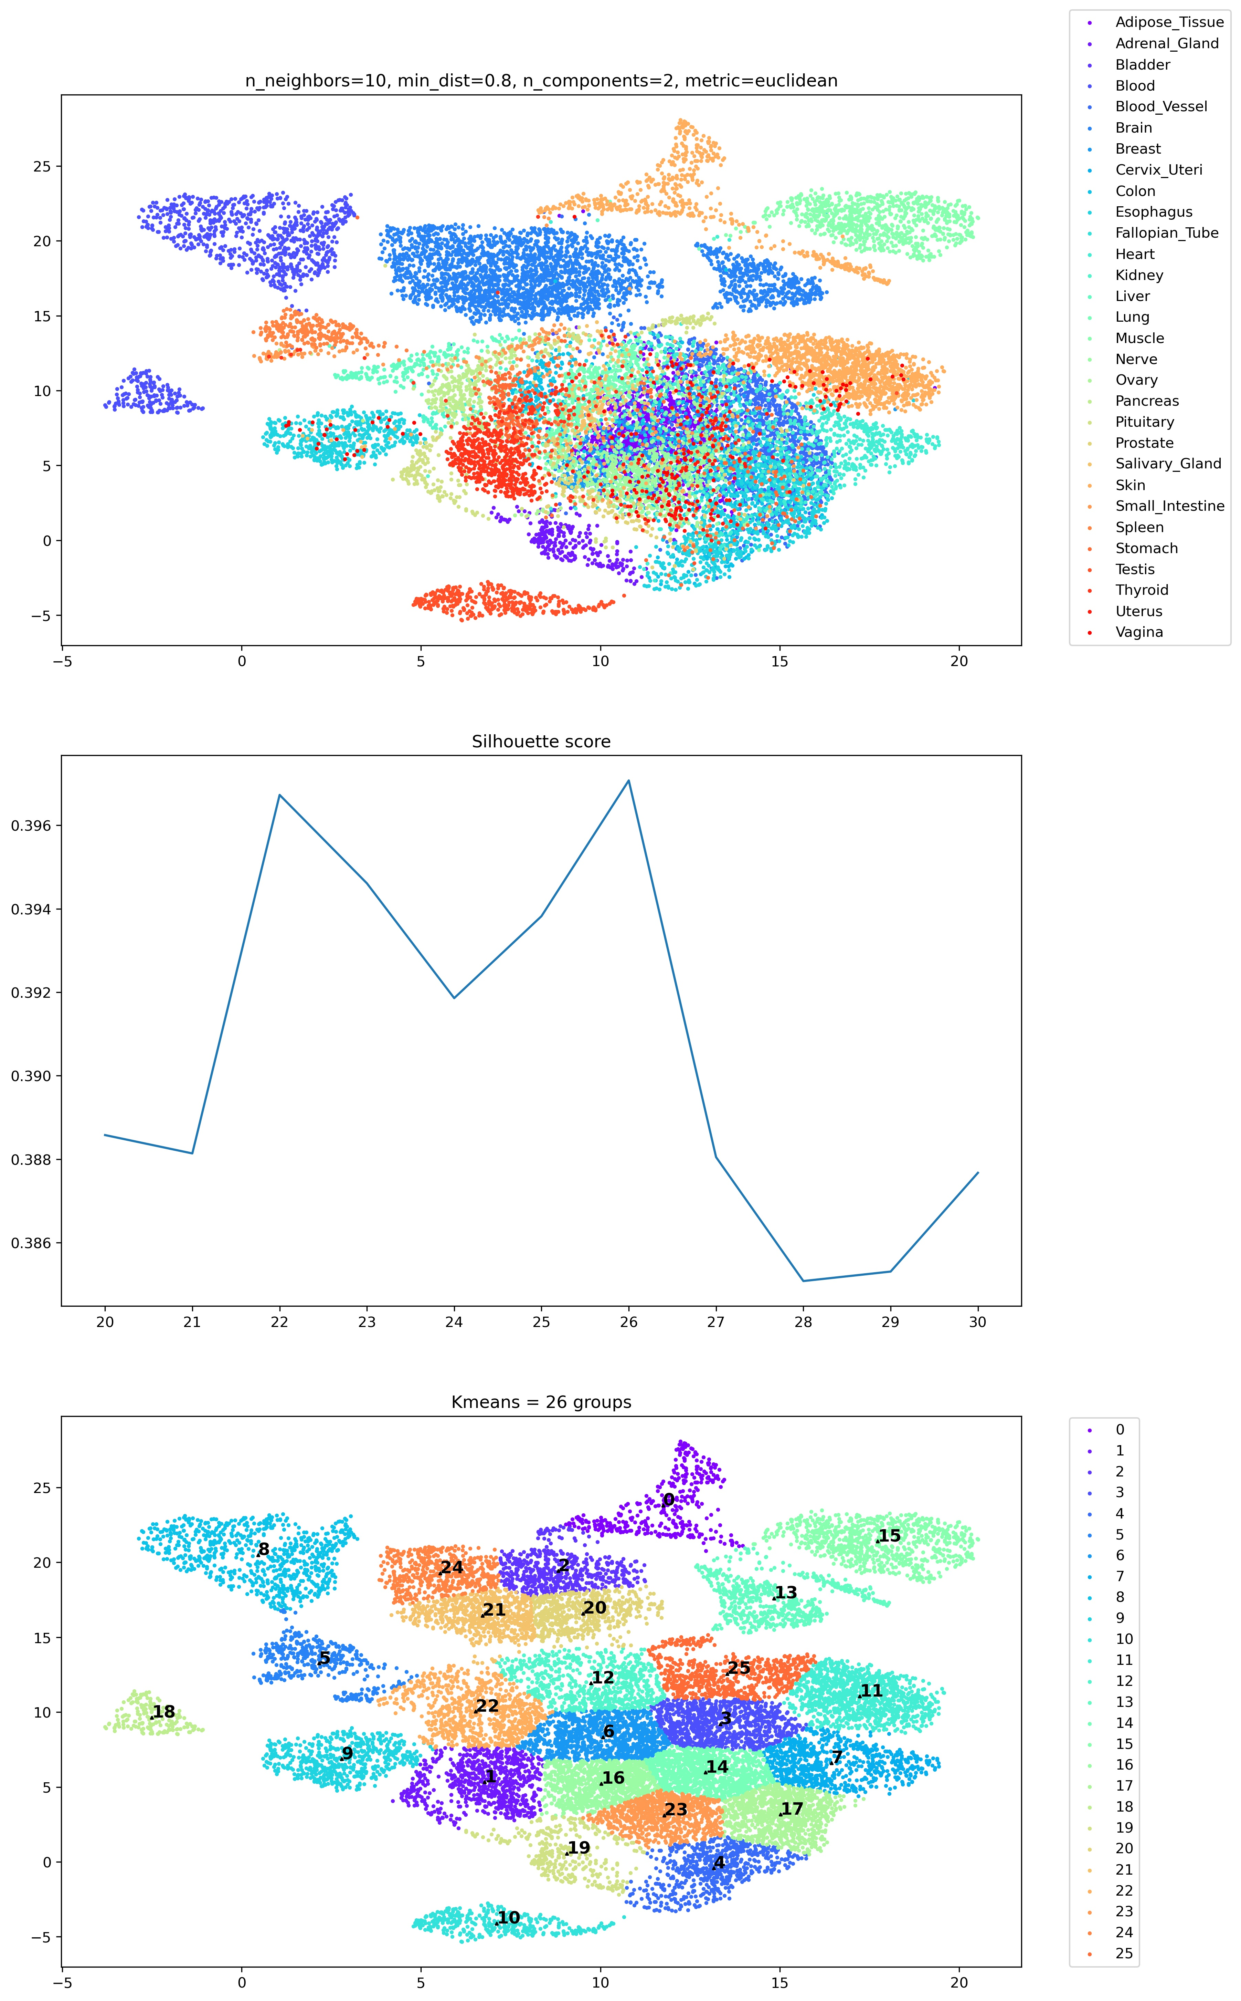
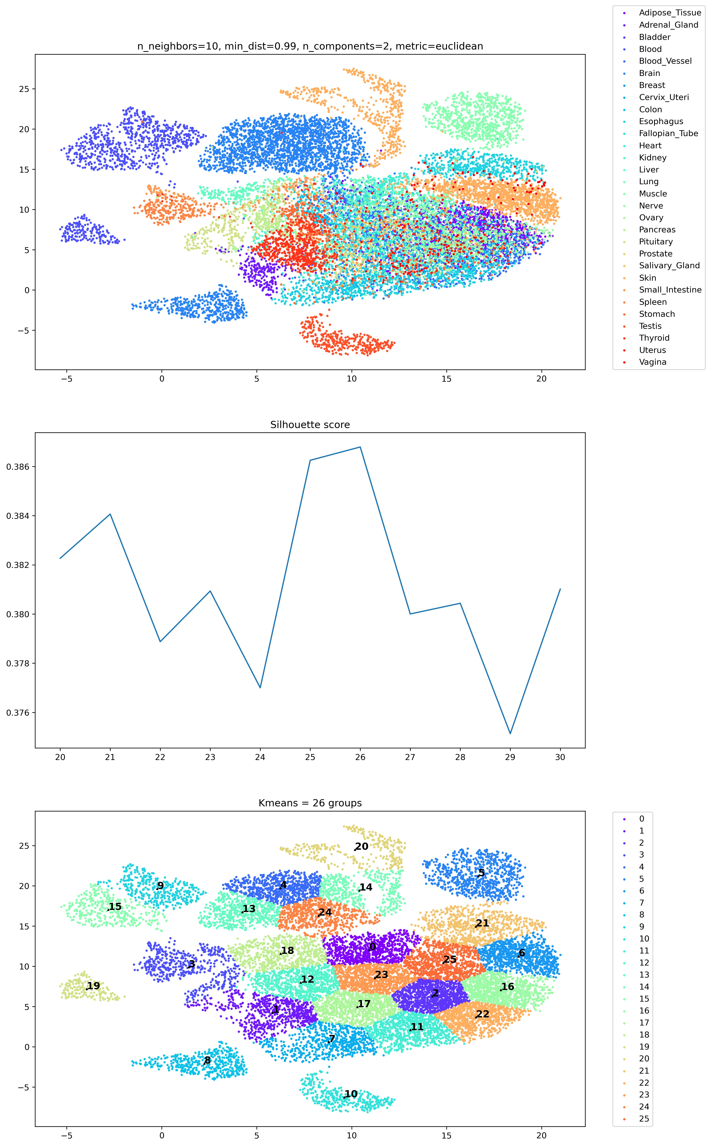
min_dist

Slide 11
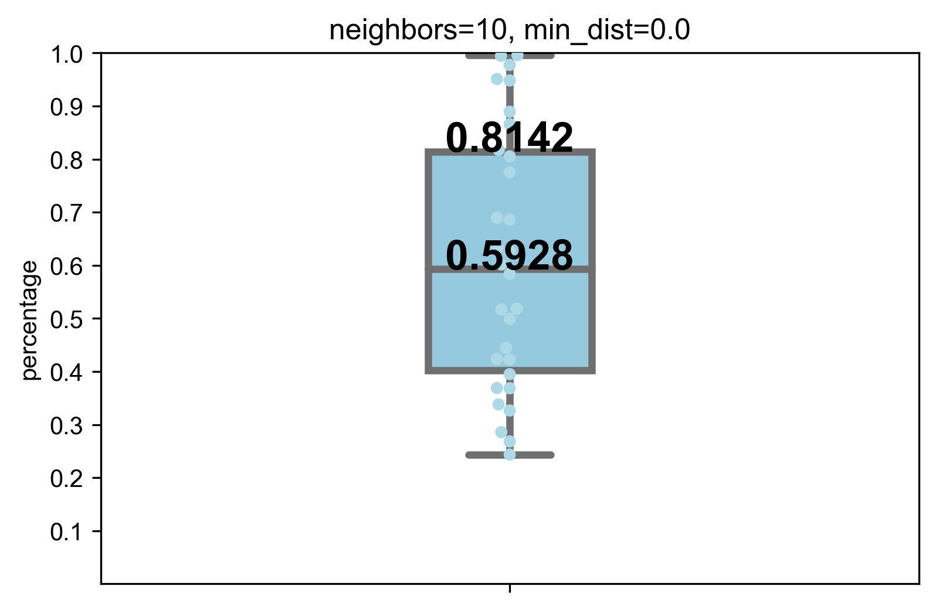

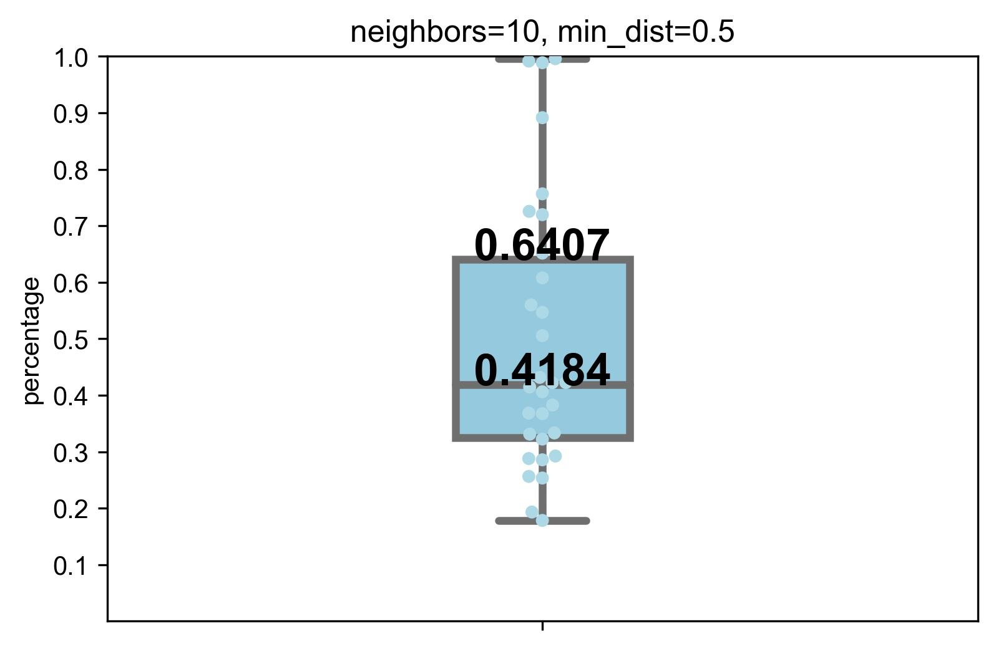
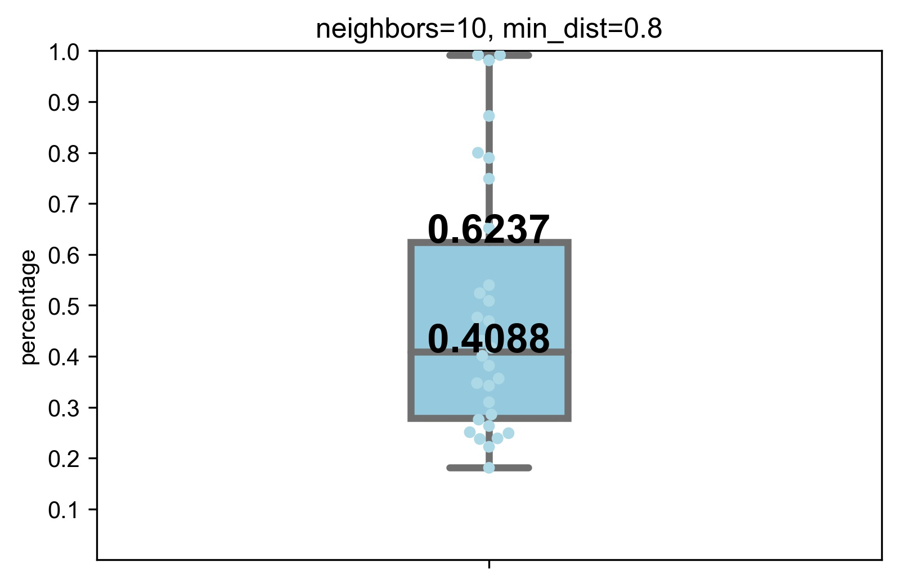
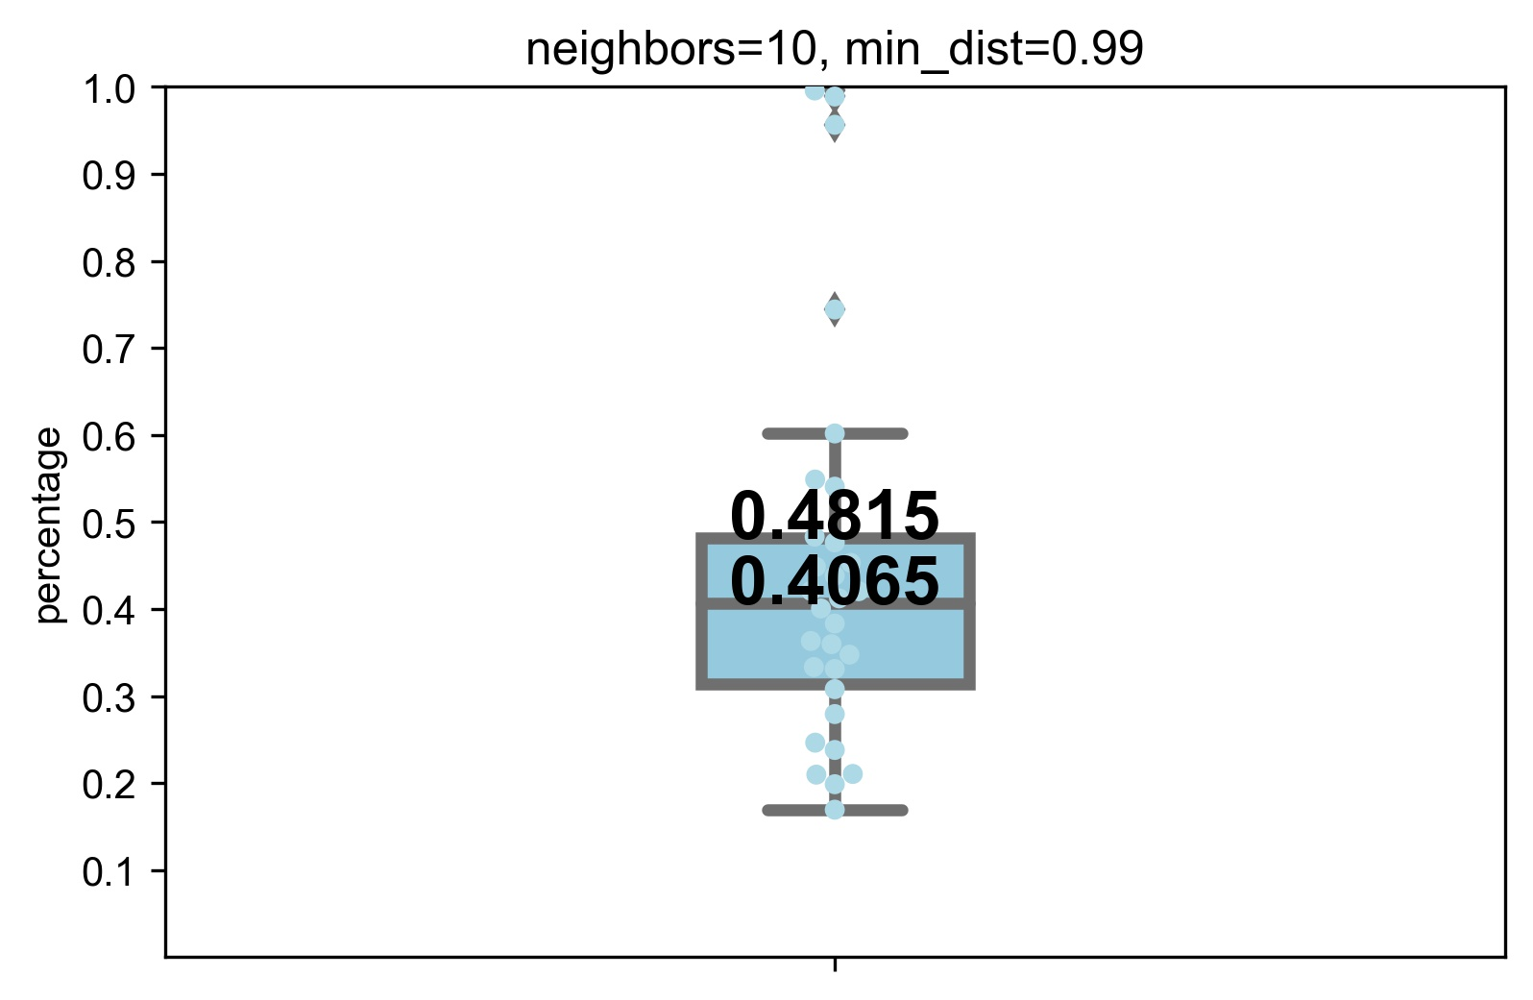
Cluster results mapping to tissue classifications

Slide 12

Optimized hyperparameters

